Slide 1



EZ-FIT:
SLIDE DECK
Take ownership of your FitBit data by empowering it with our unique suggestion system free of charge!

Slide 2
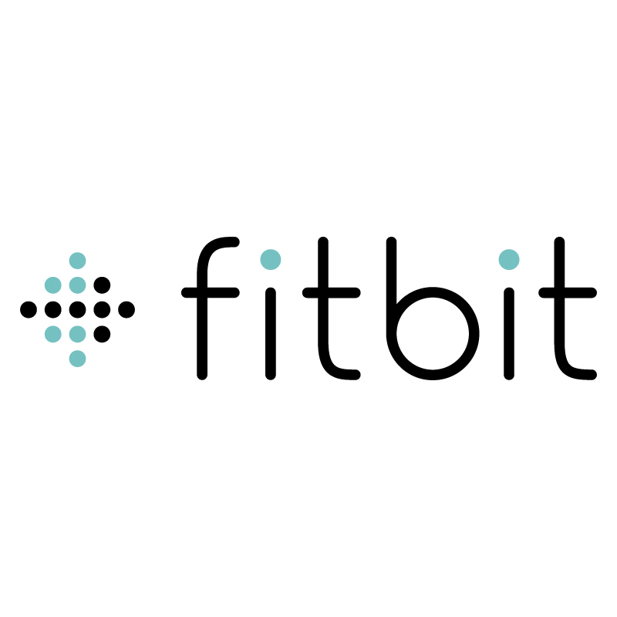



PRODUCT OVERVIEW
Link your FitBit account
Be able to fetch your FitBit data
Get personalized workout suggestions based on your data
Track injuries to take into consideration
“Fitbit’s mistake was that it promised behavior change, but it behaved like a hardware company. We had the ability to know a lot about our users, but people don’t want to be told what they did, they want to be told what to do. It’s Fitbit’s greatest missed opportunity.” -FitBit employee

Slide 3
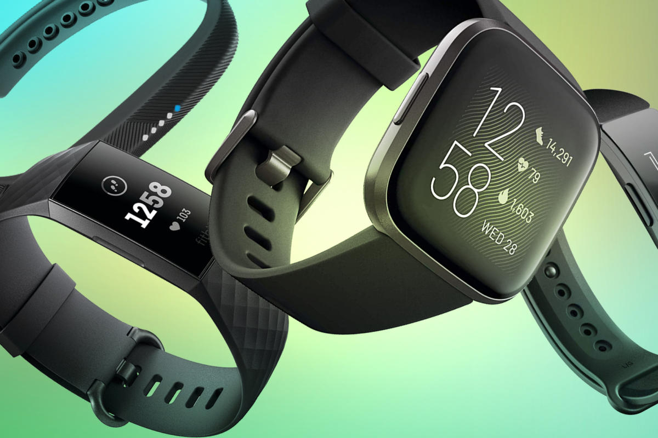
PROBLEM/OPPORTUNITY
Childhood obesity:
Many inner-city kids simply lack the guidance and motivation to go outside and exercise. We provide that spark for free.
Workout suggestions a premium:
Workout suggestions offered by FitBit are locked by default. They consider this a premium feature at a cost of $9.99/month or $79.99/year which not everyone can afford.
FitBit is AFFORDABLE:
With over 12 FitBit models to choose from ranging from cheap to expensive, it has a more far-reaching effect than any other device since ANYONE can afford one.

Slide 4
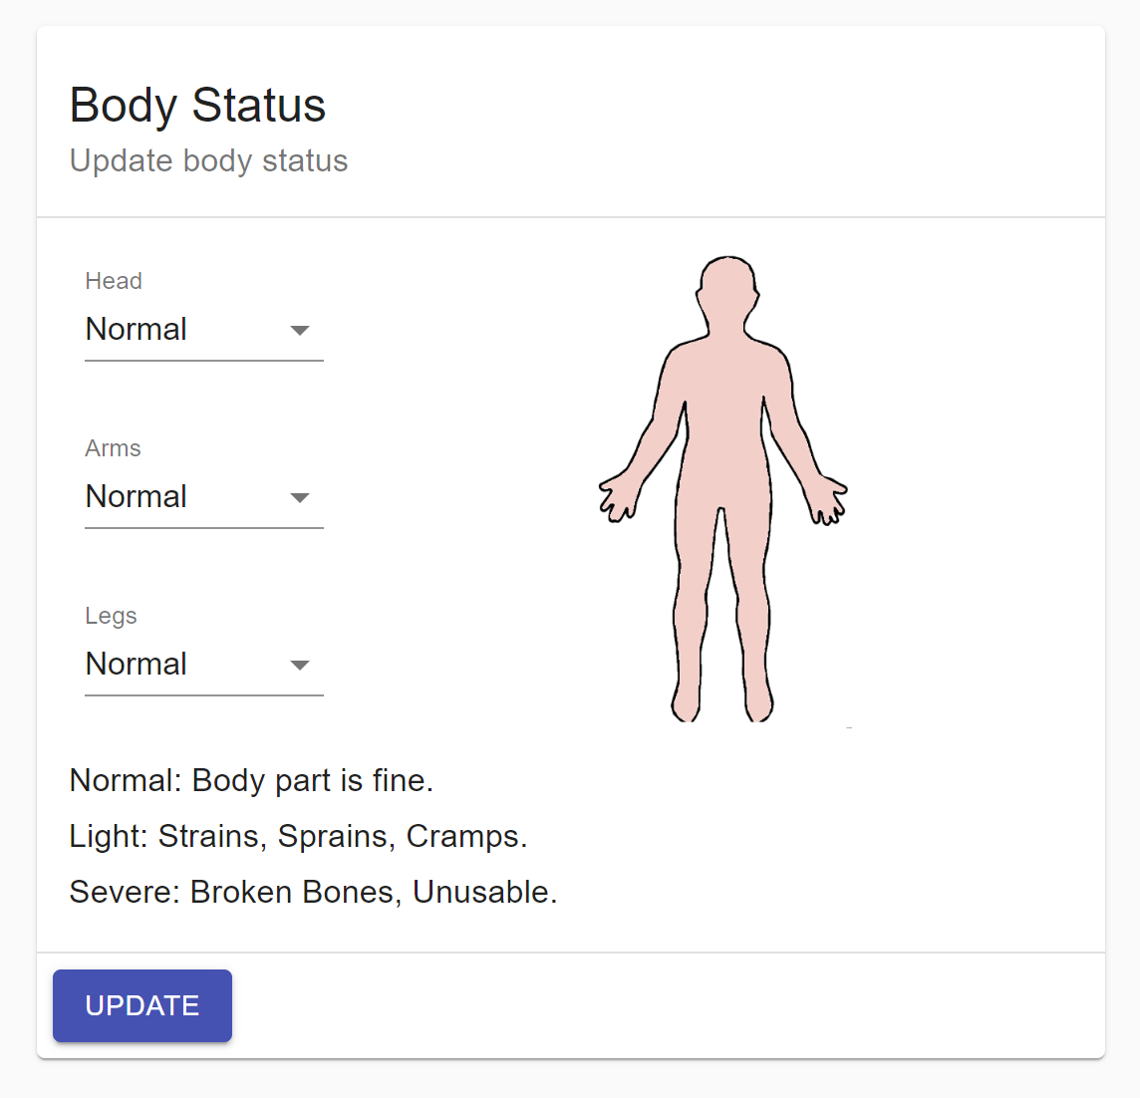
SOLUTION/VALUE
Free workout suggestions:
Using a k-means algorithm based on machine learning, we offer workout suggestions based on your current data.
Free injury tracking system:
A one-of-a-kind feature, we have the ability to track injuries you may have sustained, which our algorithm takes into consideration.
Factors we take into account:
To generate the workout suggestion, we look at the user’s body mass index, age, body fat, as well as any injuries.

Slide 5
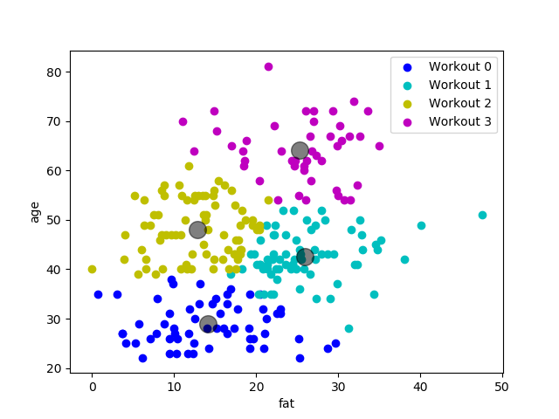
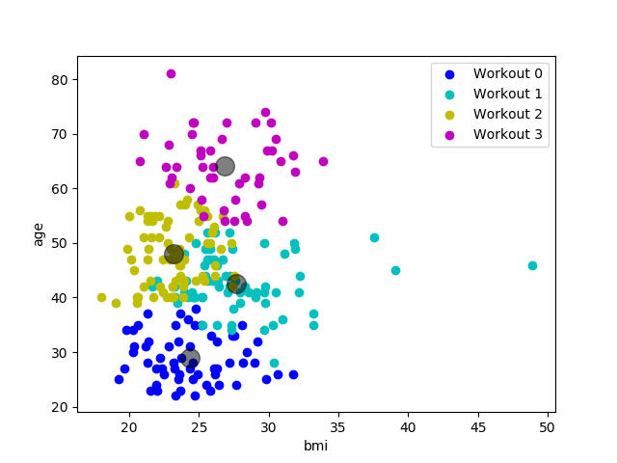
DATA VISUALIZATION
IMAGE 1:
IMAGE 2:
Fat vs. Age
BMI vs. Age

Slide 6




PRODUCT DEVELOPMENT ROADMAP
STAGE 1:
STAGE 2:
STAGE 3:
STAGE 4:
Complete user account module and integrate FitBit API
Complete dashboard and host application on Heroku
Finish the password reset and retrieval functions
Refine K-means algorithm for workout suggestions

Slide 7



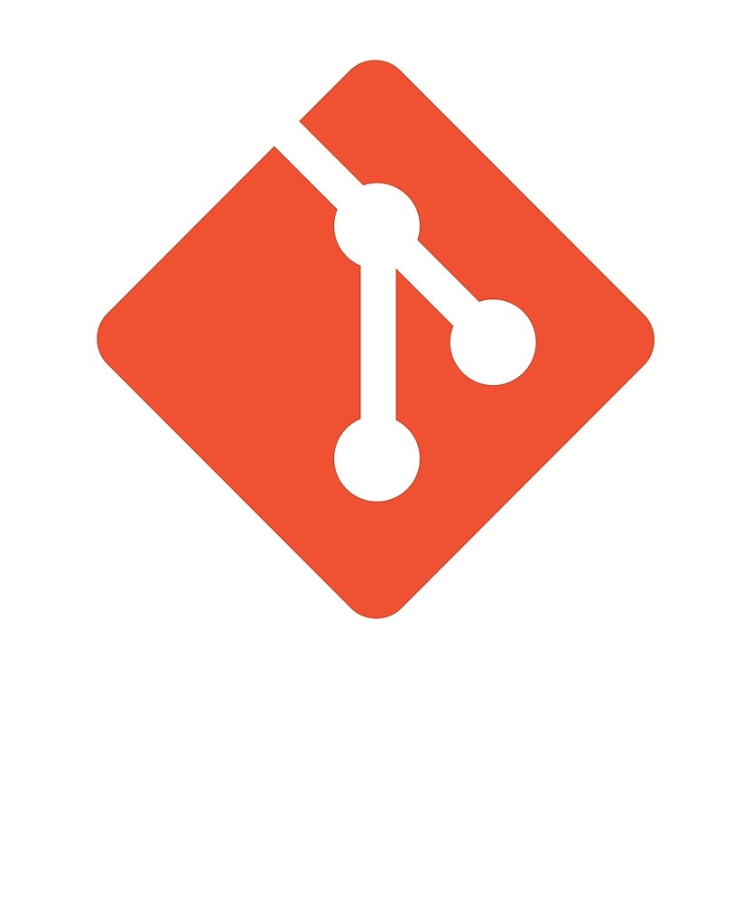



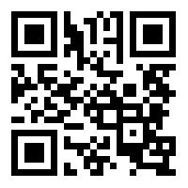
TECHNOLOGY OVERVIEW
MongoDB
Express.js
React.js
Node.js
Heroku
Git
Thanks EZ-FIT for helping me get rid of my childhood obesity to look like this! You guys ROCK!
Visit us @: EZFIT.ROCKS

Slide 8
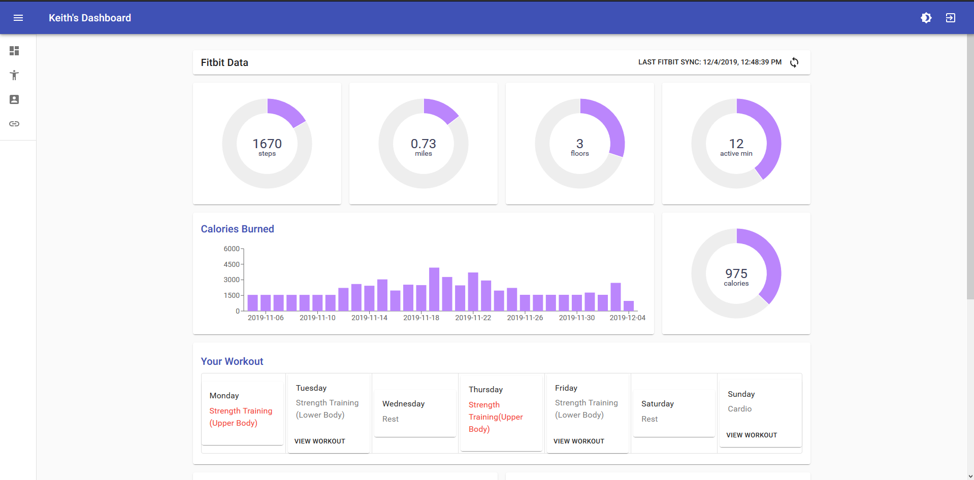
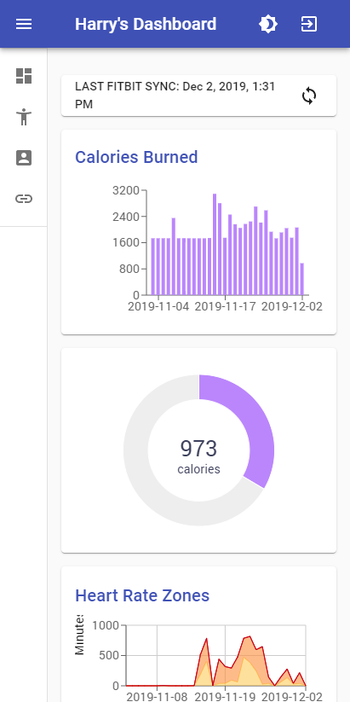
PRODUCT SCREENSHOTS
DESKTOP:
MOBILE:
PC/Windows, Mac
Android, iPhone

Slide 9
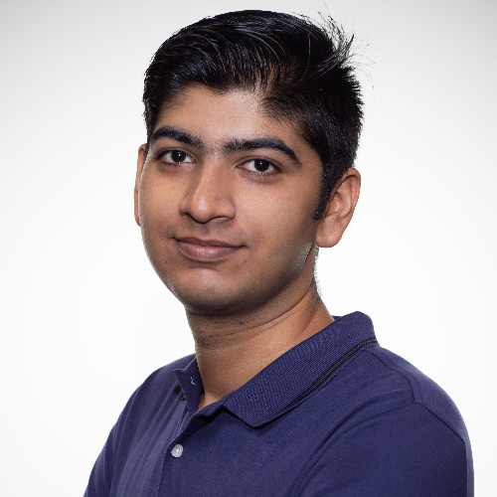

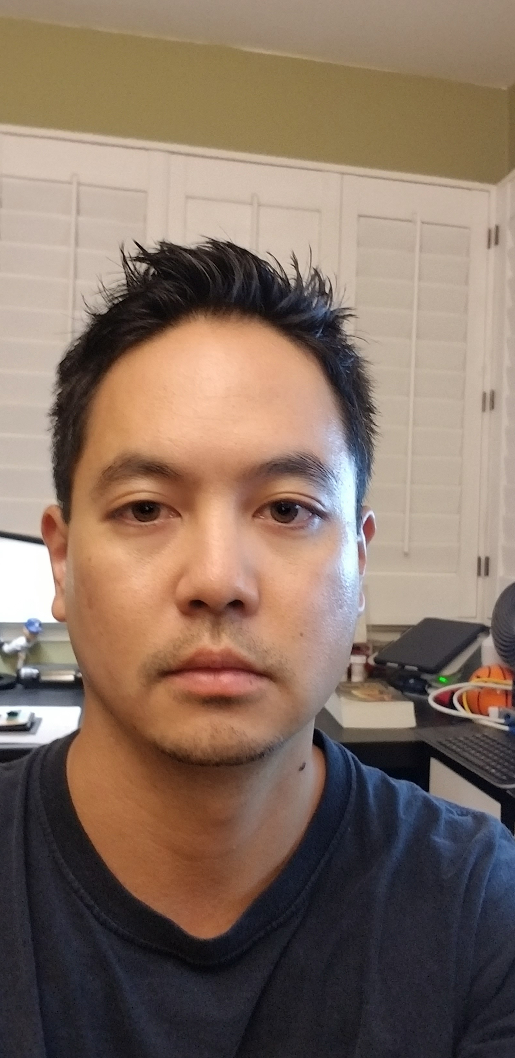
MEET OUR TEAM
ASHWIN BALACHANDRAN
HARRY PHAM
KEITH TACHIBANA
Was an intern at Kareo (medical office software company) where he will work after graduation. For this project, he was in charge of backend development.
E-mail: balachaa@uci.edu
Has worked on a team with mentors from Blizzard Entertainment (gaming company). For this project, he was in charge of frontend development.
E-mail: harrynp@uci.edu
Has worked on coding projects for JetSuite Inc. (private aviation company). For this project, he helped work on the backend development.
E-mail: tachibak@uci.edu

